Slide 1
Clientz assignment - Data Science Interview Project
Beiya Xue
beiya0130@gmail.com

Slide 2
Agenda
Problem statement
Feature impact
Proposed new feature
New feature design and experiment
Summary

Slide 3
Problem statement
Clientz is seeking to improve the SEO performance of the listing pages by identifying key factors that influence Google rankings. The objective is to determine the importance of various features in influencing a page's ranking on Google search results. Additionally, the team is asking an actionable change to Clientz’s listing pages that would positively impact conversion rate (bookings) and eventually rankings on the Google search result page (SERP).

Slide 4

DATA/model OVERVIEW
Target: Google Rank
Features: # Reviews, Number of Preview Profiles, Distance, % Cross Listed Results, % Templated Words
Number of observation: 5000
To calculate the feature importance, we need to build a model to predict Google Rank.
Model Name: XGBoost Regressor
Modeled features: All
Model accuracy: 90%

Slide 5
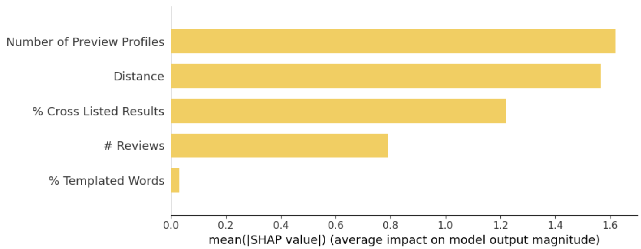
feature impact
SHAP values indicate how much each feature contributes to a specific prediction.
In below chart, features are ordered from the highest to the lowest effect on the prediction. It takes in account the absolute contribution for each data point, so it does not matter if the feature affects the prediction in a positive or negative way.
The average rank our model predict is 13.3.
The Number of Preview Profiles and Distance are the most two impactful features for predicting Google Rank, providing ~1.6 absolute impact on the final prediction. The following features are % Cross Listed Results (avg impact of 1.2) and # Reviews (avg impact of 0.8).
% Templated Words have very little impact on the Ranking.
1.62
1.57
1.22
0.79
0.03

Slide 6
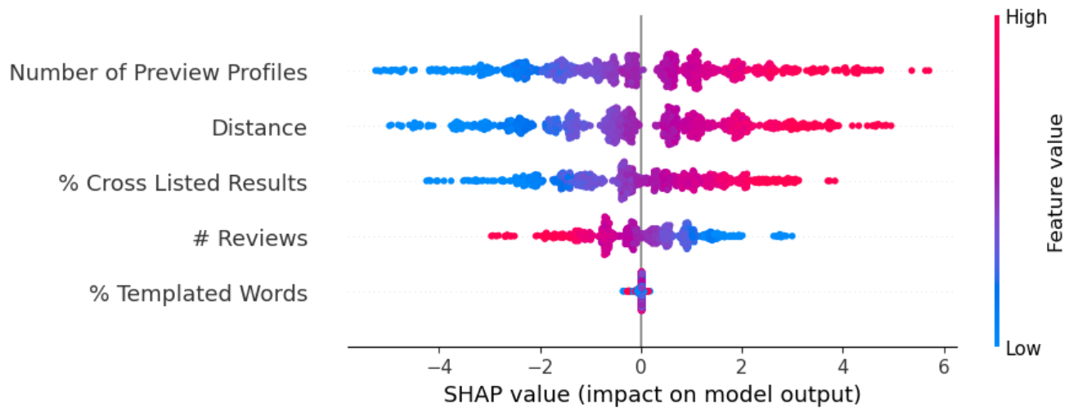
feature impact with direction
The Beeswarm plot provides a more detailed view of the SHAP values for each feature across all predictions. It shows the distribution of SHAP values for each feature, allowing you to see how each feature's value impacts the prediction for individual observations.
Except for % Templated Words, all other features have an almost evenly distributed SHAP values, meaning the contribution can be both positive or negative while predicting the Ranking. For the top two most impactful features as we saw on the previous slide, it turns out they have opposite impact on the target. On average, the average distance between the providers shown on the search result page and the searcher would have a negative impact on Google Rank.
For % Templated Words, based on observations we have collected, it rarely provides any impact on Google Rank no matter positive or negative.
0.85
-0.009
0.011
0.003
0.002

Slide 7
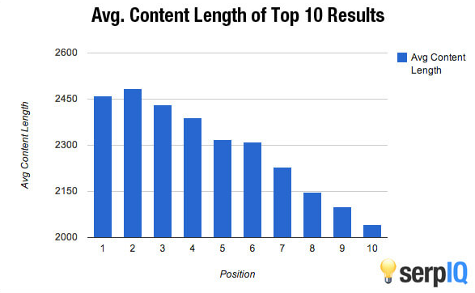
Proposed new feature
“Research suggests that content over 2000 words gets more top ten positions in Google search engine rankings.”[1]
Proposed New Feature: Length of Content
Impact on Rankings: The Length of Content will improve the rankings of the landing pages by 1 position on the Google SERP.
Impressions: Each URL in the dataset receives 1,000 impressions per month.
CTR Improvement: A 1-position improvement in ranking is associated with a 1% increase in CTR. Thus, with the proposed feature, the expected increase in CTR for our landing pages would be:
Current CTR: Assuming the current CTR for the 5th position is 5%.
New CTR: This would increase to 6% (5% + 1%).
Booking Conversion Rate: The conversion rate from an SEO landing page to booking is 20%.

Slide 8
A/B Test on new feature impact
Assuming it is possible to separate control and test groups, and conversion rate is a valid indicator of Google Rank, A/B test is a good way to set up the measurement for the impact of the new feature. Assuming we are testing for one or one type of listing of specialists, we can define below requirements with metrics mentioned in the previous slide.
Desired Metrics
Statistical Power: Generally, a power of 80% is commonly used, which means there is an 80% chance of detecting a true effect if it exists.
Significance Level: Typically set at 0.05 (5%), this is the probability of rejecting the null hypothesis when it is true.
Effect Size: This is the minimum difference you expect to see between the control (A) and treatment (B) groups. Assuming it’s 5%.
Baseline Conversion Rate: Conversion rate for control group. Assuming it’s 23%. Given the desired effect size is 5%, then the test group conversion rate is 28%.
Sample Size: 1188 (calculated)
Duration of the Experiment: 2.5 months (calculated)
Implementation
The Attracts backlinks feature will be rolled out to a sample of new users while existing users will continue to access the current version of the landing pages. We will collect data on user interactions for both groups over 2.5 months, ensuring we have enough data for robust statistical analysis.
We will use a statistical test, such as a two-tailed t-test or chi-square test, to determine if the observed difference in conversion rates is statistically significant. The test will help us assess whether the feature change has a meaningful impact on user behavior, based on the predetermined significance level (p-value < 0.05) and desired power of 80%.

Slide 9
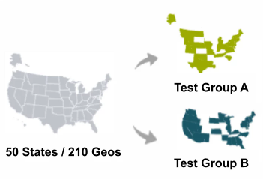
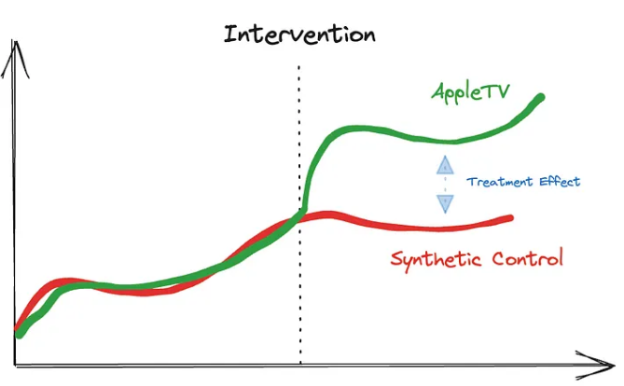
Alternatives for a/b test
For SEO, A/B tests encounter challenges due to changes in search engine behavior and spillover effects. When search engines detect new features on landing pages in the test group, it can affect rankings and traffic, complicating the isolation of the change’s impact. Furthermore, users may see both treated and untreated listings in the same search results, introducing competition between control and test pages and complicating the evaluation of the test.
To avoid these issues, a geo experiment or synthetic control experiment is more suitable. By separating test and control groups geographically, we minimize overlap in search results and ensure cleaner data. Geo experiment compares regions where the new feature is implemented against those where it is not, providing clearer insights into rankings and conversion impact. Geo experiments require selected locations to be equivalent. If states/city isn’t doable, considering DMA level is another option.
If a geo-lift study isn’t feasible, synthetic control can simulate what the treated regions’ performance would have been without the feature. Comparing this prediction to actual outcomes provides a less biased measure of the feature’s true impact.
[2]
[3]

Slide 10
Results and recommendations
Testing Overview: We conducted an A/B test to evaluate the impact of a new feature, Length of Content, on our SEO landing pages. The goal was to assess its effect on search rankings, user sessions, and ultimately, bookings. The experiment was performed on 20 selected listings over a period of 2.5 months. 1188 users are evenly split into control and test groups. We found that conversion rates remained consistent at 20%, demonstrating the feature's effectiveness in driving qualified traffic.
After rolling out the feature across the entire landing page scope, we observed the following outcomes over the next 4 months:
Rankings: Improved by 1 position on Google SERPs.
Sessions: Increased by 10% due to higher visibility.
Bookings: Rose by 15% as a direct result of increased traffic.
In summary, the new feature Length of Content positively influenced search rankings, leading to a substantial increase in organic sessions and bookings.
Recommendations:
Continue refining content length and quality to enhance engagement and search engine rankings.
Conduct A/B testing on complementary features (e.g., poage loading speed, images, videos) to further increase user engagement and conversion rates.
Establish ongoing tracking of rankings, sessions, and bookings to adapt strategies based on evolving SEO trends.

Slide 11
Appendix

Slide 12
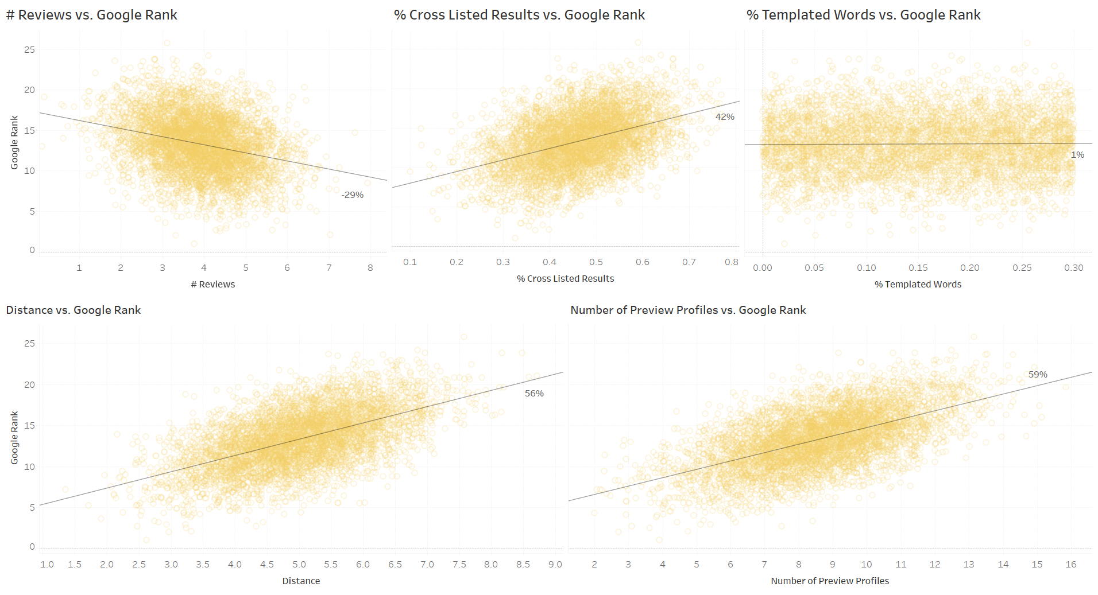
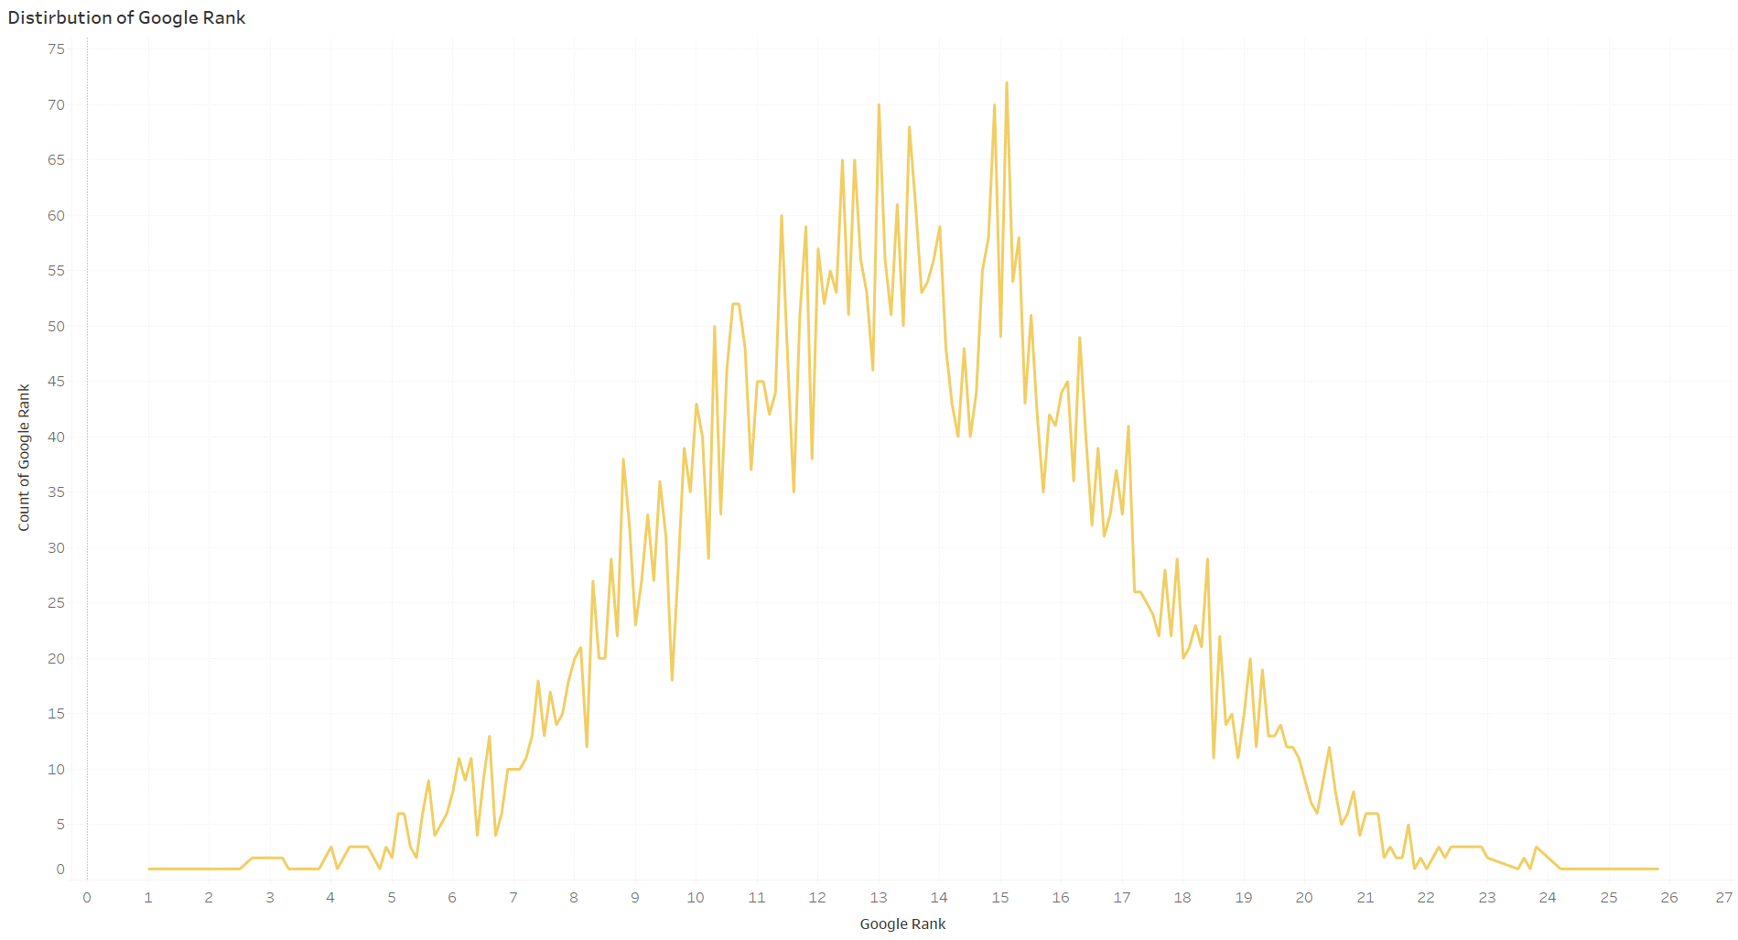
EDA
Target variable Google Rank distributes normally. No normalization is needed.
Aside from the % Templated Words feature, the other features demonstrate a strong correlation with Google Rank. The # Reviews has a negative correlation with Google Rank, indicating that more reviews are associated with better rankings.
However, focusing solely on the linear relationship between features and rankings overlooks potentially valuable hidden patterns in the non-linear space.

Slide 13
modeling
Model selection
XGBoost
Recommended for this task due to its ability to handle non-linear relationships and complex feature interactions effectively. SEO ranking factors are likely non-linear, and XGBoost’s boosting mechanism can provide strong predictive power. It also works well with small feature sets (current 5 features, with room to expand to more).
Linear Regression
While easy to interpret, it assumes a linear relationship between features and Google rank, which might miss non-linear patterns that are critical in SEO. It's less suitable for capturing complex interactions in this context.
Random Forest
A good middle ground, as it handles non-linear relationships and provides feature importance insights. However, it might not perform as well as XGBoost in terms of accuracy due to lack of boosting but is still easier to interpret than XGBoost.
For this assignment, XGBoost is ideal, with SHAP used to interpret feature importance to understand the ranking dynamics better.
Model Interpretation
Absolute Importance (Traditional Methods)
Provides a measure of how much each feature contributes to the model's predictions without indicating direction.
Pros: Simple and quick to understand.
Cons: Lacks detail on whether features positively or negatively affect predictions.
SHAP (SHapley Additive exPlanations)
Quantifies the contribution of each feature to individual predictions, showing both positive and negative impacts.
Pros: Detailed insights into feature influence.
Cons: More complex and computationally intensive.
In summary, absolute importance gives an overview, while SHAP reveals the nature of feature contributions, making it a powerful tool for understanding model behavior.

Slide 14
XGBoost Regression
Training-testing ratio: 0.8/0.2
Max-depth: 2
Training score: 0.92
Testing score: 0.90
Model predict accurately and doesn’t overfit. Therefore, the feature impact provide in the main deck is reliable.

Slide 15
Reference
[1] https://optinmonster.com/seo-ranking-factors/
[2] https://www.aboutwayfair.com/careers/tech-blog/how-wayfair-uses-geo-experiments-to-measure-incrementality
[3] https://medium.com/latinxinai/estimating-causal-impacts-with-synthetic-control-methods-87dda0b96d5d

